Slide 1
Chapter 5
E-commerce Security
Copyright © 2014 Pearson Education, Inc. Publishing as Prentice Hall

Slide 2
What Is Good E-commerce Security?
Integrity
Non-repudiation
Authenticity
Confidentiality
Privacy
Availability
Copyright © 2014 Pearson Education, Inc. Publishing as Prentice Hall
Slide 5-<number>

Slide 3
Dimensions of E-commerce Security
Integrity
ensures that info sent and received
has not been altered by
unauthorized party
Copyright © 2014 Pearson Education, Inc. Publishing as Prentice Hall
Slide 5-<number>

Slide 4
Dimensions of E-commerce Security
Non-repudiation
ability to ensure that participants do not deny (repudiate)
Copyright © 2014 Pearson Education, Inc. Publishing as Prentice Hall
Slide 5-<number>

Slide 5
Dimensions of E-commerce Security
Authenticity
ability to identify the person’s identity with whom you are dealing with over the internet
Copyright © 2014 Pearson Education, Inc. Publishing as Prentice Hall
Slide 5-<number>

Slide 6
Dimensions of E-commerce Security
Confidentiality
authorized to be seen by those
who should view it
Copyright © 2014 Pearson Education, Inc. Publishing as Prentice Hall
Slide 5-<number>

Slide 7
Dimensions of E-commerce Security
Privacy
ability to control who sees your info
Copyright © 2014 Pearson Education, Inc. Publishing as Prentice Hall
Slide 5-<number>

Slide 8
Dimensions of E-commerce Security
Availability
e-commerce site functions as intended
Copyright © 2014 Pearson Education, Inc. Publishing as Prentice Hall
Slide 5-<number>

Slide 9
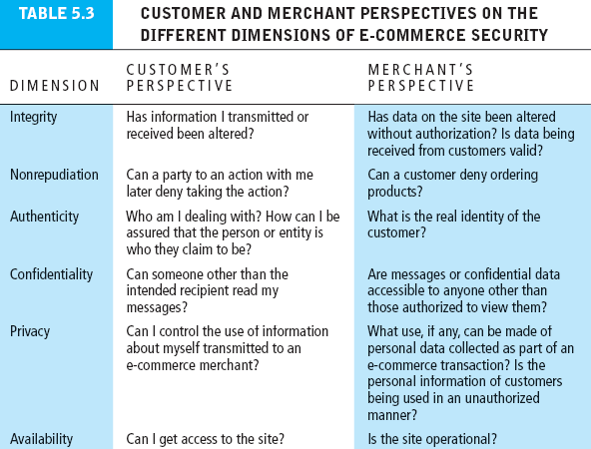
Table 5.3, Page 254
Copyright © 2014 Pearson Education, Inc. Publishing as Prentice Hall
Slide 5-<number>

Slide 10
The Tension Between Security and Other Values
  The more security measures added, the more difficult a site is to use, and the slower it becomes
  Security costs money and too much of it can reduce profitability
Copyright © 2014 Pearson Education, Inc. Publishing as Prentice Hall
Slide 5-<number>

Slide 11
Security Threats in E-commerce Environment
Three key points of vulnerability in e-commerce environment:
  Client
  Server
  Communications pipeline (Internet communications channels)
Copyright © 2014 Pearson Education, Inc. Publishing as Prentice Hall
Slide 5-<number>

Slide 12
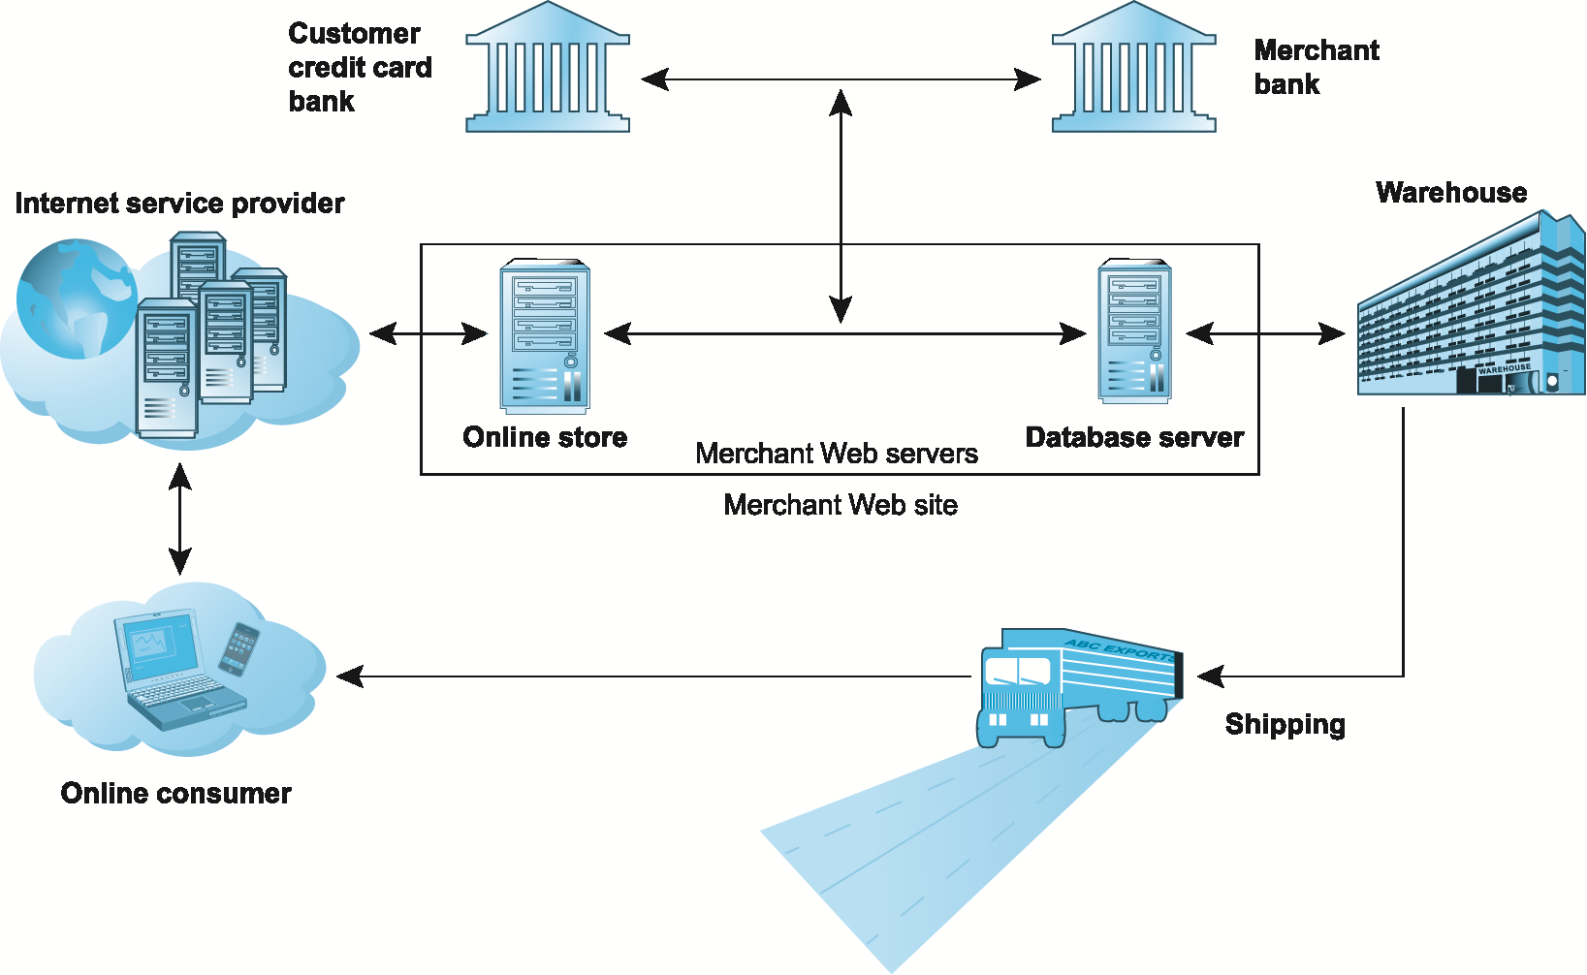
A Typical E-commerce Transaction
Figure 5.2, Page 256
Copyright © 2014 Pearson Education, Inc. Publishing as Prentice Hall
Slide 5-<number>

Slide 13
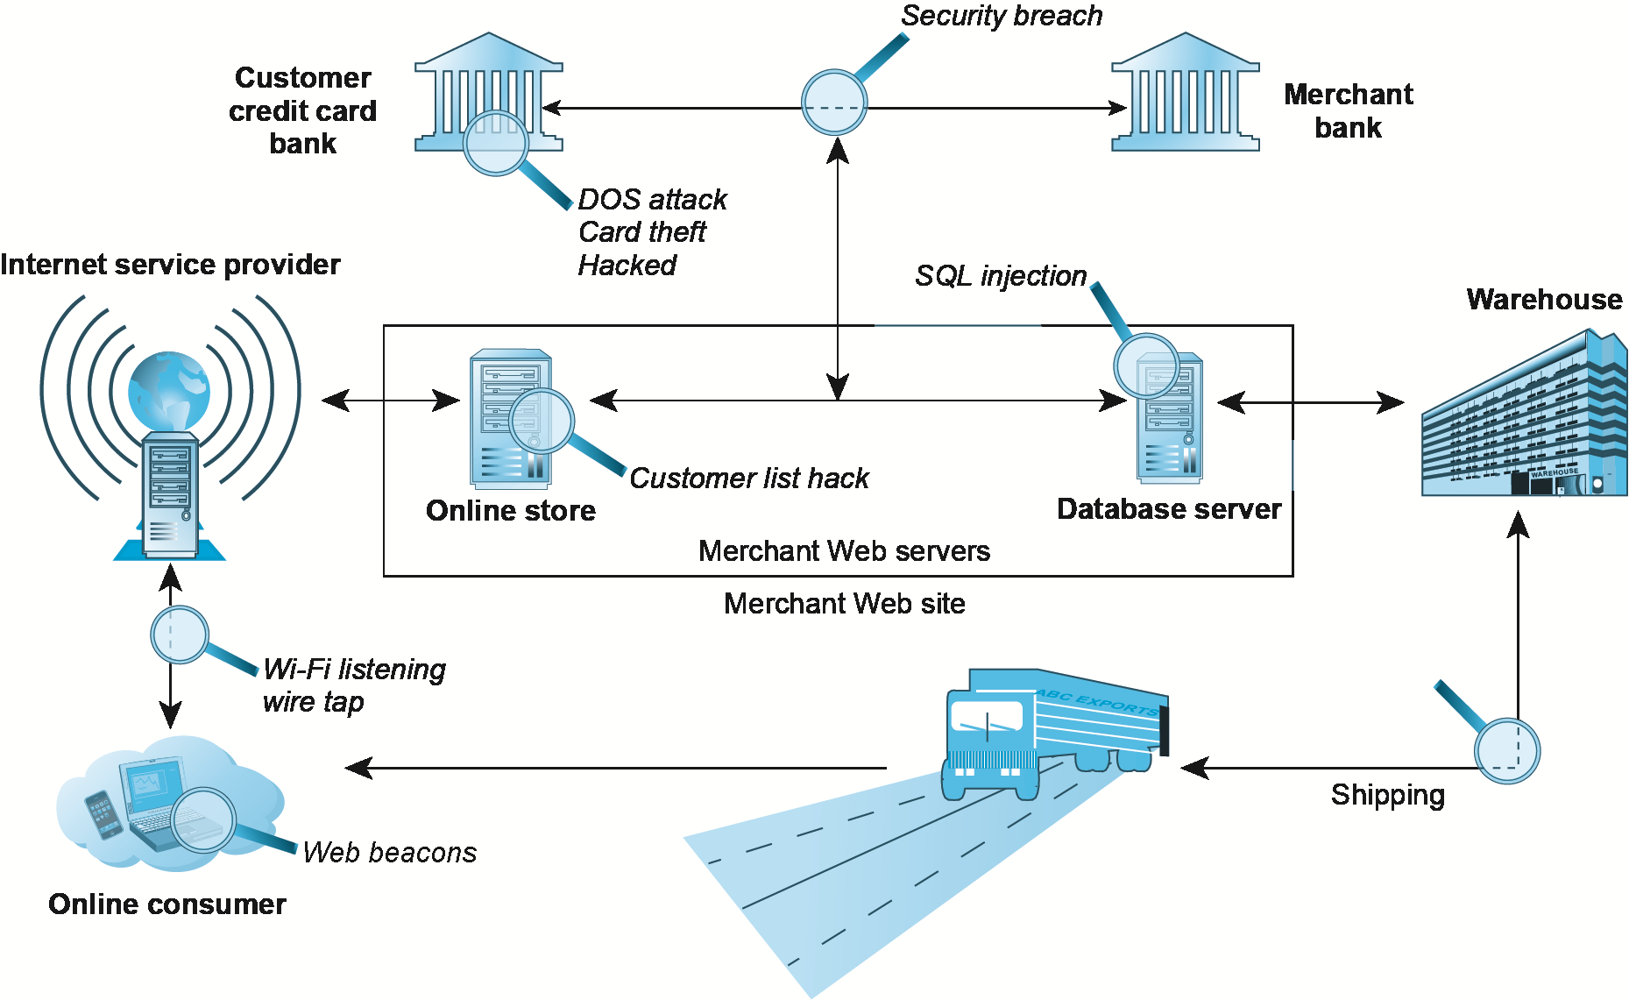
Vulnerable Points in an E-commerce Transaction
Figure 5.3, Page 257
Copyright © 2014 Pearson Education, Inc. Publishing as Prentice Hall
Slide 5-<number>

Slide 14
Most Common Security Threats in the
E-commerce Environment
  Drive-by downloads
  malware that comes with a downloaded file
  the user intentionally or
  unintentionally request
Slide 5-<number>

Slide 15
Most Common Security Threats in the
E-commerce Environment
  Viruses
  a computer program that has the ability to replicate or make copies of itself, and spread to other files
Slide 5-<number>

Slide 16
Most Common Security Threats in the
E-commerce Environment
  Worms
  spread from computer to computer
  without human intervention
Slide 5-<number>

Slide 17
Most Common Security Threats in the
E-commerce Environment
  Trojan horse
  appear to benign, but then
  does something other than expected
Slide 5-<number>

Slide 18
Most Common Security Threats in the
E-commerce Environment
  Backdoor
  feature of viruses, worms and Trojans that
  allows an attacker to remotely access
  a compromised computer
Slide 5-<number>

Slide 19
Most Common Security Threats in the
E-commerce Environment
  Bots
  type of malicious code that responds to
  external commands sent by the attacker
  (making computer acts like a robot)
  Botnets: collection of captured bot computers
Slide 5-<number>

Slide 20
Most Common Security Threats in the
E-commerce Environment
  Potentially unwanted programs (PUPs)
  program that installs itself on a computer, typically without the
  user’s informed consent
Slide 5-<number>

Slide 21
Most Common Security Threats in the
E-commerce Environment
Phishing
  engineering relies on human curiosity, greed, and gullibility to trick users into taking action that results into downloading malware
Copyright © 2014 Pearson Education, Inc. Publishing as Prentice Hall
Slide 5-<number>

Slide 22
Most Common Security Threats (cont.)
Hacking
  Hackers gain unauthorized access
    White hat role is to help identify and fix vulnerabilities
    Black hat intent on causing hard
    Grey hat breaks in to expose flaws and report them without disrupting the company. They may even try to profit from the event
  Crackers have criminal intent
  Hacktivist are politically motivated (Green Peace)
Copyright © 2014 Pearson Education, Inc. Publishing as Prentice Hall
Slide 5-<number>

Slide 23
Most Common Security Threats (cont.)
Credit card fraud/theft
Spoofing involves attempting to hide a true identity by using someone else’s email or IP address
Pharming automatically directing a web link to a fake address
Spam (junk) Web sites (link farms) promise to offer products but are just full of ads
Identity fraud/theft involves unauthorized/illegal use of another person’s data
Denial of service (DoS) attack Hackers flood site with useless traffic to overwhelm network
Distributed denial of service (DDoS) attack
Copyright © 2014 Pearson Education, Inc. Publishing as Prentice Hall
Slide 5-<number>

Slide 24
Most Common Security Threats (cont.)
Denial of service (DoS) attack Hackers flood site with useless traffic to overwhelm network
Distributed denial of service (DDoS) attack uses numerous computers to launch attacks on sites or computers systems. The attack comes from several locations
Copyright © 2014 Pearson Education, Inc. Publishing as Prentice Hall
Slide 5-<number>

Slide 25
Most Common Security Threats (cont.)
Sniffing, a sniffer is a type of eavesdropping program that monitors information traveling over a network
Insider attacks caused by employees
Poorly designed server and client software leads to SQL injection attacks by taking advantage of poorly coded applications that fails to validate data entered by web users
Zero-Day vulnerability software vulnerability that is reported but no current fix exists
Social network security issues
Copyright © 2014 Pearson Education, Inc. Publishing as Prentice Hall
Slide 5-<number>

Slide 26
Most Common Security Threats (cont.)
Mobile platform security issues
  Vishing targets gullible cell ph users with verbal messages to call
  Smishing exploits SMS/text messages that may contain links and other personal info that may be exploited
  Madware is innocent looking apps containing adware that launches pop-up ads and text messages on you mobile device
Cloud security issues example, DDoS attacks threaten the availability and viability of cloud services
Copyright © 2014 Pearson Education, Inc. Publishing as Prentice Hall
Slide 5-<number>

Slide 27
Think Your Smartphone Is Secure?
Have you ever experienced unusual phone performance/activities? What and why?
In the future, will apps or web sites be the winner?
Copyright © 2014 Pearson Education, Inc. Publishing as Prentice Hall
Slide 5-<number>

Slide 28
Smartphone Threat
Juice jacking
Installation of malware, or copying personal data from a digital device using double charging port
Copyright © 2014 Pearson Education, Inc. Publishing as Prentice Hall
Slide 5-<number>

Slide 29
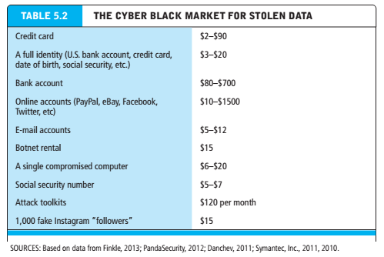
Copyright © 2014 Pearson Education, Inc. Publishing as Prentice Hall
Slide 5-<number>

Slide 30
Technology Solutions
Protecting Internet communications
  Encryption altering plain text so that it cannot be read by anyone other than the sender & receiver
  It provides security for 4 of 6 security dimensions
    Integrity by ensuring the messages has not been tampered with
    Nonrepudiation by preventing users from denying they sent the message
    Authentication by verifying the person’s identity or computer sending the message
    Confidentiality by ensuring the message was not read by others
Copyright © 2014 Pearson Education, Inc. Publishing as Prentice Hall
Slide 5-<number>

Slide 31
Types of Encryption
Cipher
where letters of the message are replaced systematically by another letter
Example: HELLO -> KOFFE
Copyright © 2014 Pearson Education, Inc. Publishing as Prentice Hall
Slide 5-<number>

Slide 32
Types of Encryption
Transportation cipher
ordering the letters in some systematic way (reverse order,…)
Example: HELLO -> OLLEH
HELLO -> EFFOK
Copyright © 2014 Pearson Education, Inc. Publishing as Prentice Hall
Slide 5-<number>

Slide 33
Types of Encryption
Symmetric key
both sender and receiver use the same key to encrypt and decrypt the message.
The key is sent over a secure line or exchanged in person
Copyright © 2014 Pearson Education, Inc. Publishing as Prentice Hall
Slide 5-<number>

Slide 34
Symmetric Key Encryption
Sender and receiver use same digital key to encrypt and decrypt message
Requires different set of keys for each transaction
Strength of encryption
  Length of binary key used to encrypt data
Data Encryption Standard (DES)
Advanced Encryption Standard (AES)
  Most widely used symmetric key encryption
  Uses 128-, 192-, and 256-bit encryption keys
Other standards use keys with up to 2,048 bits
Copyright © 2014 Pearson Education, Inc. Publishing as Prentice Hall
Slide 5-<number>

Slide 35
Types of Encryption
Public Key there are two mathematically related keys, a public key and private key. Private key key secretly by owner and public key disseminated to the public. Both keys are used to encrypt and decrypt the message. Once the keys are used, they can no longer be used to unencrypt the message. They are one-way irreversible functions.
Hash function creates a fixed length number that replaces the original message, then the hash is used to recreate the message on the recipient side (fig 5.7)
Digital signature is a signed cipher text sent over the internet
Copyright © 2014 Pearson Education, Inc. Publishing as Prentice Hall
Slide 5-<number>

Slide 36
Types of Encryption
Digital envelope uses symmetric encryption for large docs
Digital certificate (DC) issues by trusted 3rd party known as certification authority that contains (the subject name, public key, digital cert serial #, exp date, issuance date and digital signature)
  There are various types of certs (personal, institutional, web server, software publ, and Cas)
  Verisign, post office, Fed Reserve issue certs
Key infrastructure (PKI) when you sign into a secure site you see the “s” or the lock which means the site has a digital certificate issued by a CA
Copyright © 2014 Pearson Education, Inc. Publishing as Prentice Hall
Slide 5-<number>

Slide 37
Public Key Encryption using Digital Signatures and Hash Digests
Hash function:
  Mathematical algorithm that produces fixed-length number called message or hash digest
Hash digest of message sent to recipient along with message to verify integrity
Hash digest and message encrypted with recipient’s public key
Entire cipher text then encrypted with recipient’s private key—creating digital signature—for authenticity, nonrepudiation
Copyright © 2014 Pearson Education, Inc. Publishing as Prentice Hall
Slide 5-<number>

Slide 38
Technology Solutions
Securing channels of communication
  Secure Socket Layer; a secure negotiated session is a client server session in which the URL of the requested doc, its contents, and cookies are encrypted through a series of communication handshakes between computers. A unique symmetric encryption session key is chosen for each session
  VPNs allow computers to securely communicate via tunneling by adding invisible encrypted wrappers around messages to hide their contents
Slide 5-<number>

Slide 39
Technology Solutions
Securing channels of communication
  Protecting networks
  Firewalls are hard/software that filters comm packets and prevent unauthorized access
  They filter traffic based on packets, IP address, type of service http, www, domain name etc
  2 Ways to validate traffic
    Packet filters examine whether they are destined for a prohibited port or originate from one
    App gateway filters traffic based on the app being requested
Copyright © 2014 Pearson Education, Inc. Publishing as Prentice Hall
Slide 5-<number>

Slide 40
Technology Solutions
Proxy servers are software servers handle comm by acting as a spokesperson and body guard for the organization. To local computers, proxy servers are known as a gateway, but to external servers known as mail server. Proxy servers sit betw users and back end systems. They may be used to restrict access by employees.
Securing channels of communication
  Protecting networks
Slide 5-<number>

Slide 41
Technology Solutions
Securing channels of communication
  Protecting networks
    Intrusion detection systems IDS monitor traffic looking for patterns or preconfigured rules that may indicate an attack
    IPS (prevention) prevents attacks by taking action to block the attack
Copyright © 2014 Pearson Education, Inc. Publishing as Prentice Hall
Slide 5-<number>

Slide 42
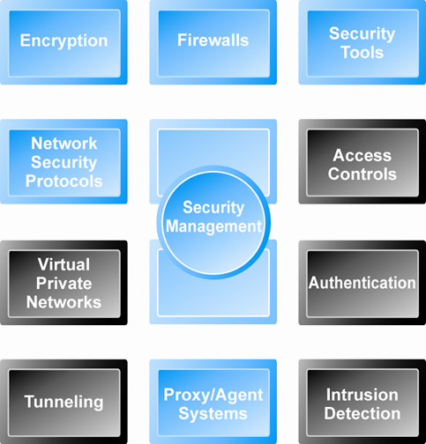
Tools Available to Achieve Site Security
Figure 5.5, Page 276
Copyright © 2014 Pearson Education, Inc. Publishing as Prentice Hall
Slide 5-<number>

Slide 43
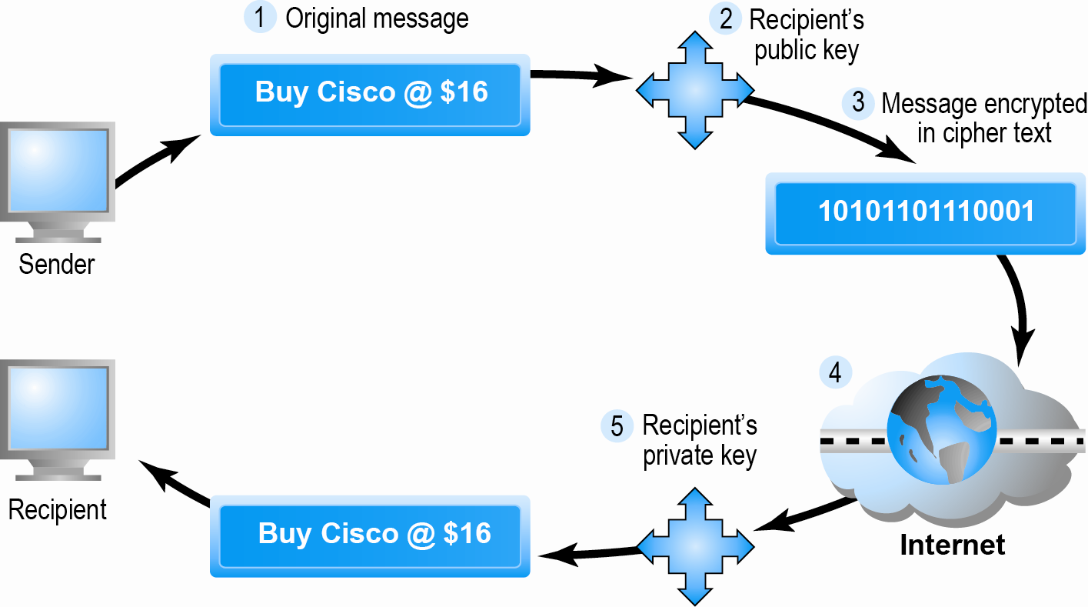
Public Key Cryptography: A Simple Case
Figure 5.6, Page 279
Copyright © 2014 Pearson Education, Inc. Publishing as Prentice Hall
Slide 5-<number>

Slide 44
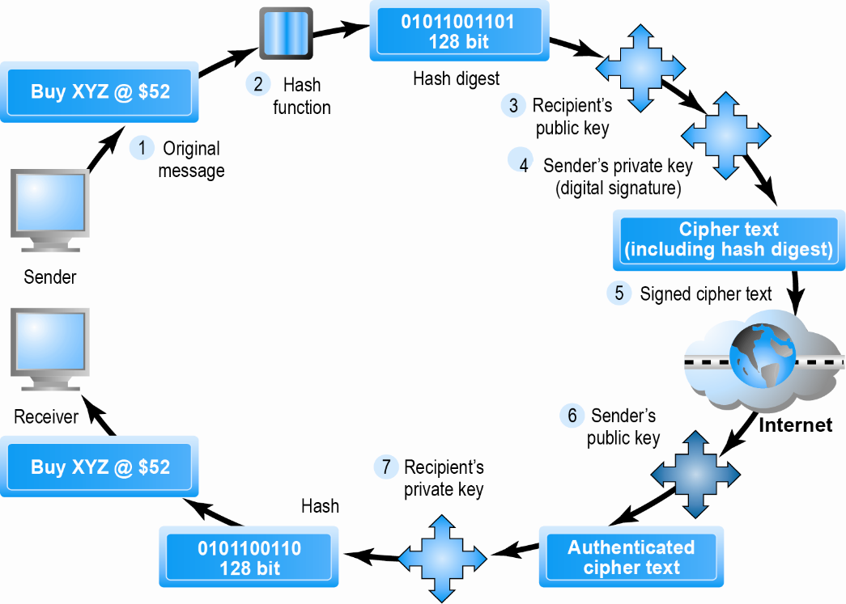
Public Key Cryptography with Digital Signatures
Figure 5.7, Page 281
Copyright © 2014 Pearson Education, Inc. Publishing as Prentice Hall
Slide 5-<number>

Slide 45
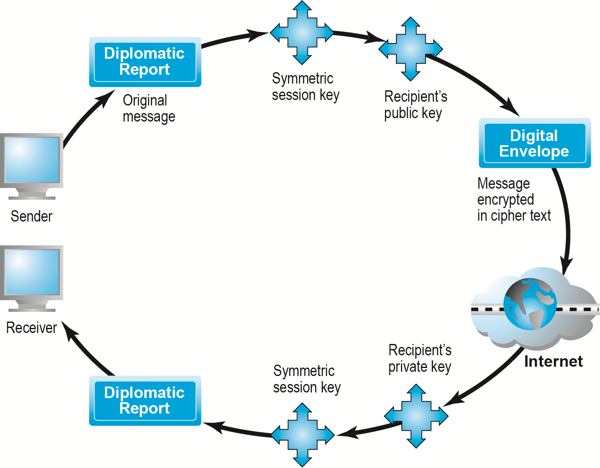
Creating a Digital Envelope
Figure 5.8, Page 282
Copyright © 2014 Pearson Education, Inc. Publishing as Prentice Hall
Slide 5-<number>

Slide 46
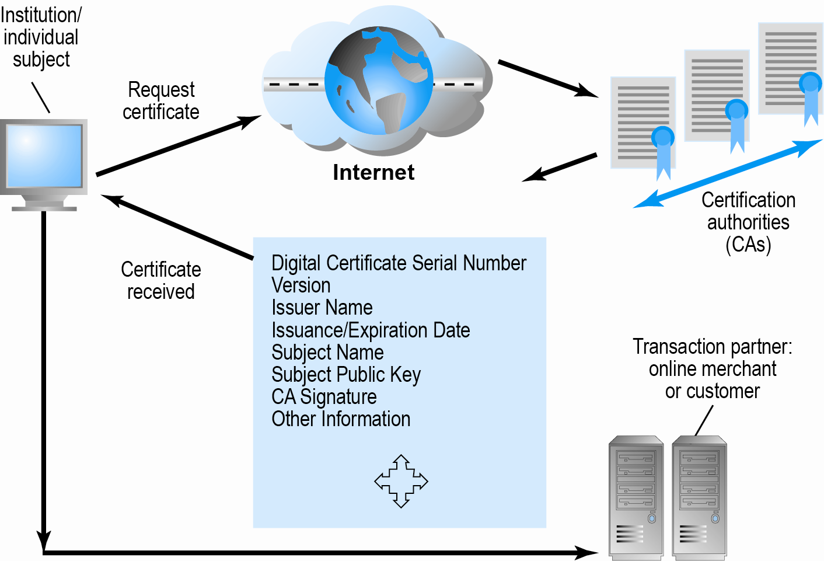
Digital Certificates and Certification Authorities
Figure 5.9, Page 283
Copyright © 2014 Pearson Education, Inc. Publishing as Prentice Hall
Slide 5-<number>

Slide 47
Limits to Encryption Solutions
Doesn’t protect storage of private key
  PKI not effective against insiders, employees
  Protection of private keys by individuals may be haphazard
No guarantee that verifying computer of merchant is secure
CAs are unregulated, self-selecting organizations
Copyright © 2014 Pearson Education, Inc. Publishing as Prentice Hall
Slide 5-<number>

Slide 48
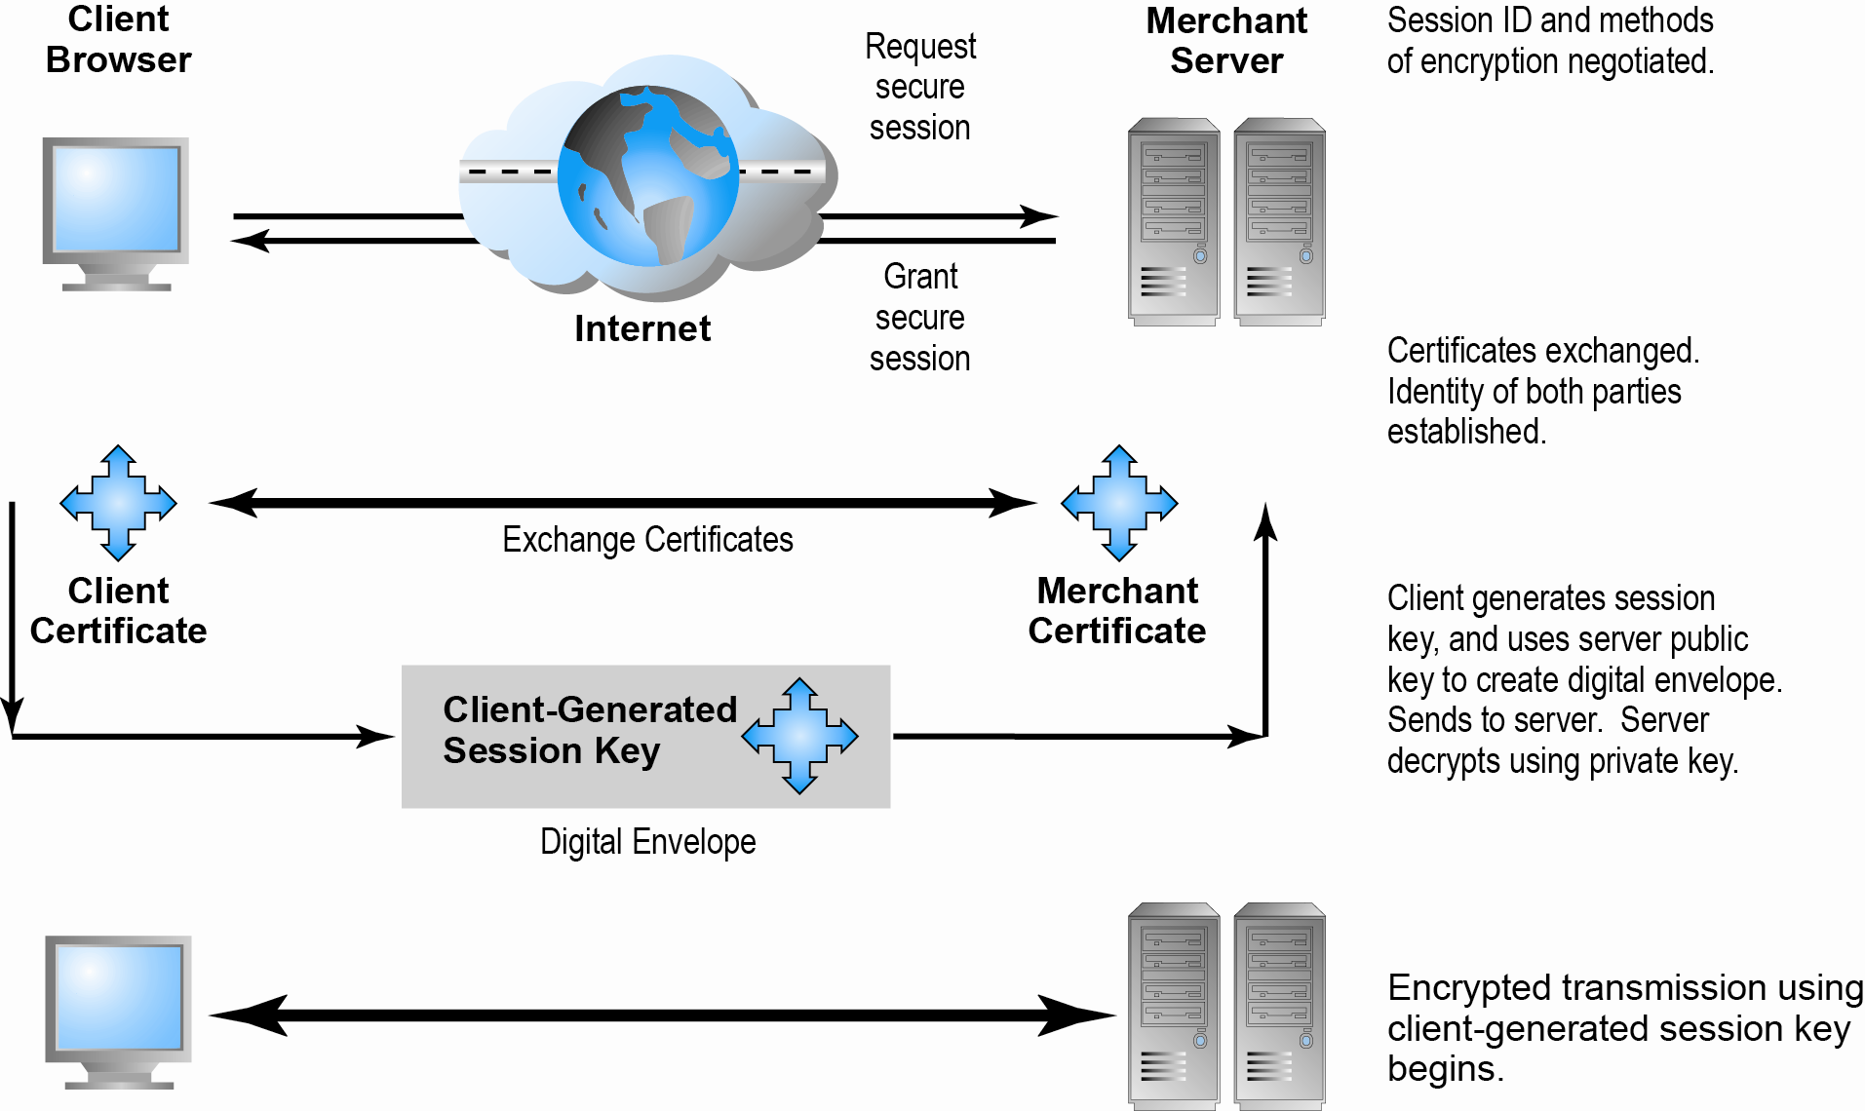
Secure Negotiated Sessions Using SSL/TLS
Figure 5.10, Page 286
Copyright © 2014 Pearson Education, Inc. Publishing as Prentice Hall
Slide 5-<number>

Slide 49
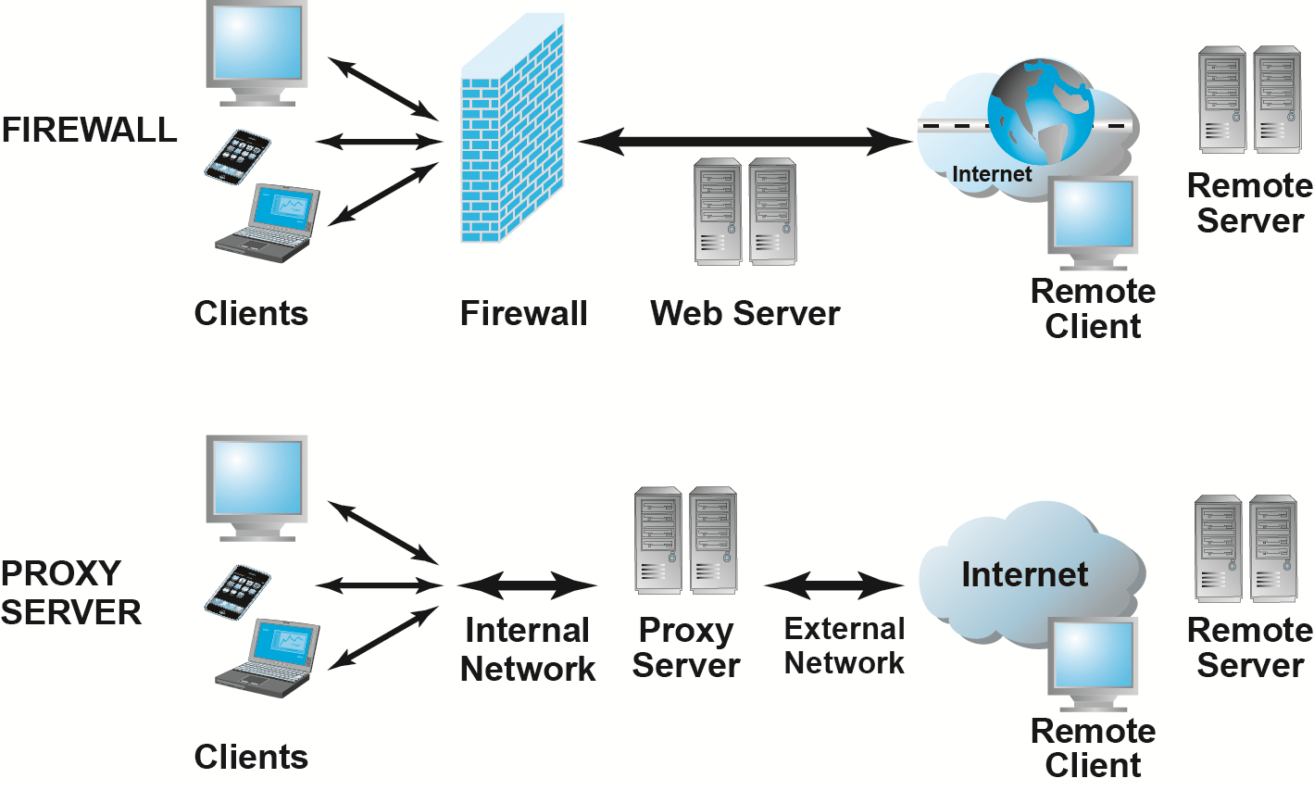
Firewalls and Proxy Servers
Figure 5.11, Page 289
Copyright © 2014 Pearson Education, Inc. Publishing as Prentice Hall
Slide 5-<number>

Slide 50
Protecting Servers and Clients
Operating system security enhancements
  Upgrades, patches
Anti-virus software
  Easiest and least expensive way to prevent threats to system integrity
  Requires daily updates
Copyright © 2014 Pearson Education, Inc. Publishing as Prentice Hall
Slide 5-<number>

Slide 51
Management Policies, Business Procedures, and Public Laws
Worldwide, companies spend more than $65 billion on security hardware, software, services
Managing risk includes:
  Technology
  Effective management policies
  Public laws and active enforcement
Copyright © 2014 Pearson Education, Inc. Publishing as Prentice Hall
Slide 5-<number>

Slide 52
A Security Plan: Management Policies
Risk assessment
Security policy
Implementation plan
  Security organization
  Access controls
  Authentication procedures, including biometrics
  Authorization policies, authorization management systems
Security audit provides ability to audit access logs for security breaches and unauthorized use
Copyright © 2014 Pearson Education, Inc. Publishing as Prentice Hall
Slide 5-<number>

Slide 53
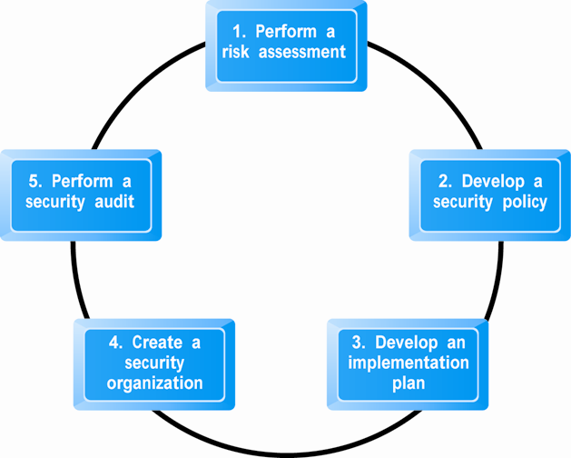
Developing an E-commerce Security Plan
Figure 5.12, Page 291
Copyright © 2014 Pearson Education, Inc. Publishing as Prentice Hall
Slide 5-<number>

Slide 54
The Role of Laws and Public Policy
Laws that give authorities tools for identifying, tracing, prosecuting cybercriminals:
  National Information Infrastructure Protection Act of 1996
  USA Patriot Act
  Homeland Security Act
Private and private-public cooperation
  CERT Coordination Center
  US-CERT
Government policies and controls on encryption software
  OECD, G7/G8, Council of Europe, Wassener Arrangement
Copyright © 2014 Pearson Education, Inc. Publishing as Prentice Hall
Slide 5-<number>

Slide 55
Bitcoin
Have you or anyone you know ever used Bitcoin?
What are some of the benefits of using a digital currency?
What are the risks involved to the user?
What do you think about Bitcoin’s future?
Copyright © 2014 Pearson Education, Inc. Publishing as Prentice Hall
Slide 5-<number>

